Slide 1
Predicting Steering Angles for a Self Driving Car Section 4
Notes:
In this section we are going to look at some of the computer vision and AI technology used in self driving cars, specifically an approach to predict the steering angle based on a feed of images of the road ahead.

Slide 2
What we will cover in this section
IMPORTANT REMINDER!!
How can we predict steering angles for a car
What are convolutional neural networks (CNNs)
Environment and dataset
Exploring our data
Training our model
Testing our model
Notes:
This slide, like mentioned above is for multiple pointers. The information above covers the types of information that can be used in this slide
https://aws.amazon.com/blogs/machine-learning/build-your-own-face-recognition-service-using-amazon-rekognition/

Slide 3
THIS CODE IS NOT DESIGNED FOR REAL LIFE USAGE!
Notes:
So let’s start with a very important message, this code is not designed to run on a real car. There are a large number of safety features that a real autonomous vehicle has that we won’t cover here. However, section is designed to introduce you to an approach to do this, and can help you get started on a career in this space if you so wish!

Slide 4
4.1 CNNs
Notes:
In this section we are going to look at some of the computer vision and AI technology used in self driving cars, specifically an approach to predict the steering angle based on a feed of images of the road ahead. A widely used technology in this space is called the Convolutional Neural Network

Slide 5
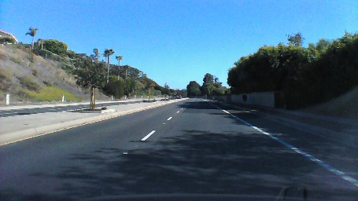
How can we predict the steering angle of a car?
Convolutional
Neural Network
+1.45 degrees
Notes:
Predicting the steering angle can be done in a number of ways. It is possible to detect the lines in the road using computer vision techniques, calculate any angle in them, and use this to determine an appropriate steering angle. Another approach is to use deep learning. We are going to use a convolutional neural network to learn patterns in road images and predict steering angles. Our training data will consist of multiple road images and a corresponding steering angle captured from a car.

Slide 6
What are Convolutional Neural Networks (CNNs)
CNNs are a class of deep, feed-forward artificial neural networks, most commonly applied to analyzing visual imagery.
They are modelled on the visual cortex where individual neurons respond to stimuli only in a restricted region of the visual field known as the receptive field.
CNNs use relatively little pre-processing compared to other image classification algorithms.
Notes:
Convolutional networks were inspired by biological processes[4] in that the connectivity pattern between neurons resembles the organization of the animal visual cortex. Individual cortical neurons respond to stimuli only in a restricted region of the visual field known as the receptive field. The receptive fields of different neurons partially overlap such that they cover the entire visual field.
CNNs use relatively little pre-processing compared to other image classification algorithms. This means that the network learns the filters that in traditional algorithms were hand-engineered. This independence from prior knowledge and human effort in feature design is a major advantage.
Yann Lecun pioneered the use of convolutional neural networks.

Slide 7
What are Convolutional Neural Networks (CNNs)
Notes:
In this image you can see how a CNN has learnt to identify edges and textures, the builds higher level representations, such as the parts of a car, then more complete images of a car before finally recognising that, in this image, it’s an Audi A7. None of these representations are programmed, the network learns these from training examples.

Slide 8
4.2 Environment and Data
Notes:
Now let’s discuss the environment we will need and the data we will use to train our model

Slide 9
What we will cover
Environment
Where to get the dataset
Size of the dataset
Viewing the datasets steering angles
What observations can be made?

Slide 10
Environment
This model requires a powerful PC, preferably with a GPU, or use of a cloud GPU instance
It took many hours to train to a level where the predicted angles were accurate enough for demo purposes
Please check Python version compatibility with Tensorflow!
Notes:
Expected to take about a few days to train on a decent spec Macbook Pro
Took approx. 5 hours on a 2core 13GB VM in Google cloud using a Nvidia K80 GPU
However, I’ve provided a pre-trained model so you can still work with the code and understand what it is doing
Note that at this point in time, Tensorflow wasn’t compatible with Python 3.7. I used Python 3.6 and TF 1.11 here!

Slide 11
Dataset
The dataset is available here:
You can download it with the following script:
Note that the image is approx. 3GB in size
Notes:
You can download the dataset from this link, or alternatively run the Unix shell script to download it. Note that it is approximately 3GB compressed, so this may take a while depending on your internet connection bandwidth.

Slide 12
Let’s explore the dataset…
Notes:
As you can see, a large percentage of the dataset has a steering angle of between -5 and +5 degrees. This can potentially cause training issues where the algorithm may get 70% accuracy by just returning 0 as the answer! Obviously this won’t be a good thing in a real car!!

Slide 13
4.3 Training Our Model
Notes:
Now we have data, let’s build a model and train it to predict steering angles.

Slide 14
Training our model
Creating training, validation and test datasets
Keras CNN definition
Loss functions
Debugging hints and tips
Analysing training performance

Slide 15
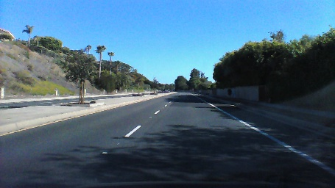
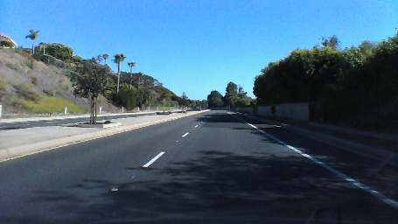
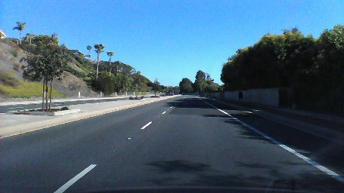
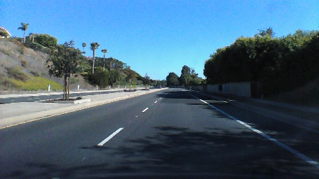
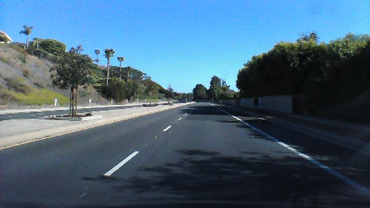
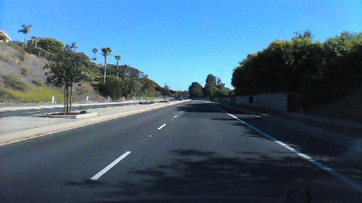
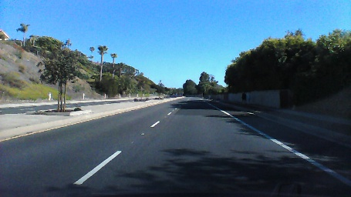
Splitting our data into train, validate and test datasets
Data set | Frames
Training | 0, 2, 4, 6, 8, 10, 12, …
Validation | 1, 5, 9, …
Test | 3, 7, 11, …
Notes:
We split the data into training, validation and testing to help train the model and understand how it predicts previously unseen examples.
During a typical training exercise, training data is used to train the model, then validation data is used to understand how well it predicts after that epoch. For example, if I train on 128 images, I would then validate how accurate the prediction was on another 128 samples.
Once the model is fully trained, you would test it on the final 20% to see how accurate it is.
This is one option of splitting the data, another way could be to take the first 60% as training data, the next 20% as validation, and the final 20% as test data.

Slide 16
Pre-processing the image
We resize and crop the image, focusing on the road as this is the region of interest for predicting steering angles.
Resizing reduces the amount of processing for each image

Slide 17
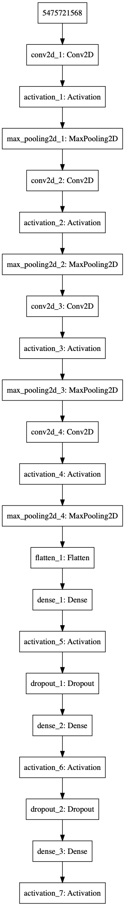
Our CNN
Angle
Notes:
Our CNN is built up of a 5 convolutional layers followed by 3 fully connected layers. Dropout is used to improve training performance by effectively dropping connections between artificial neurons. It makes those that remain more resilient to the underlying data.
The image of the CNN architecture is created by Keras, and you can analyse it in more detail by looking at the code, which we’ll do next, and by looking at the original image in the logs directory for this section.

Slide 18
Let’s explore the code…
Notes:
Look at the model, generators, and the training code. Generators and the training code are similar to section 3.

Slide 19
Debugging Neural Networks
Training neural networks can be more trial-and-error than science
Prove the code works by running a small number of samples and a single batch
Train using a small number of samples to check that the model converges and you see overfitting
Increase the number of samples over time
Make changes to the network architecture, hyper-parameters, etc. to find an optimal solution
Then scale to the full dataset
See https://keras.io/getting-started/faq/#why-is-the-training-loss-much-higher-than-the-testing-loss
Notes:
This is the approach I use for training neural networks. Typically I would perform the initial training and tuning locally to ensure the code is working and the model is starting to converge or a small number samples before moving to a cloud based server to train on the full dataset.
Also, Keras disables drop-out on validation so you will notice that the validation loss is often lower than the training loss. This is OK if you have dropout in the network, but if you don’t and you see this, then you have issues relating to your data (for example you need to think about the split between train and validation more, such as validation may be skewed to a smaller set of examples than the training data)

Slide 20
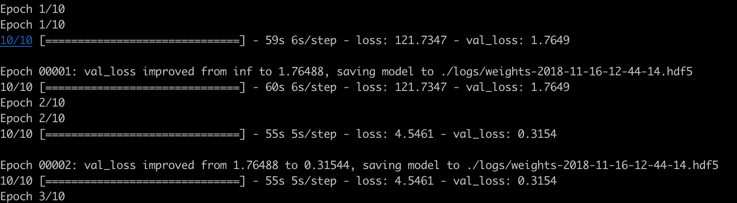
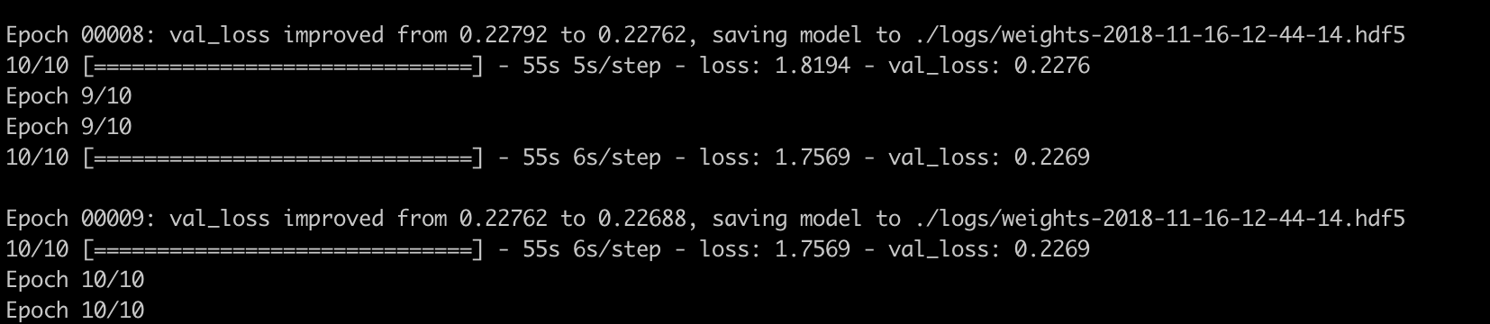


Analysing Training Performance
We are looking for the [training] loss and validation loss to decrease over time
python3 train.py -epochs 10 -limit-batches 10 -debug Y
python3 train.py –epochs 200 # Train on the full dataset
Notes:
Here’s an example of training and validation losses converging from training our convolutional neural network. I’ve shown this with just 10 batches and training for 10 epochs (or 10 iterations through those 10 batches).
To train on the full dataset, I ran training for 200 epochs.

Slide 21
4.4 Inferring Steering Angles
Notes:
In this section we are going to look at some of the computer vision and AI technology used in self driving cars, specifically an approach to predict the steering angle based on a feed of images of the road ahead.

Slide 22
Testing Our Model
Predicting steering angles
Creating a video of this in action
Notes:
In this section we will take our trained model and use it to predict steering angles. We’ll use all of the images in our dataset for this in order to create a video of our model in action.

Slide 23
THIS CODE IS NOT DESIGNED FOR REAL LIFE USAGE!
Notes:
So let’s reiterate a very important point, this code is not designed to run on a real car. There are a large number of safety features that a real autonomous vehicle has that we aren’t covering here.

Slide 24
Let’s explore the code…
Notes:
Walk through how we predict angles
Smooth out steering angle changes for the steering wheel
Generate a video

Slide 25
How to make it better?
Use a larger dataset
Augment the data
Skew the image for the next frame to reflect what would happen with the predicted steering angle
Notes:
Some of the things that could be done to improve the model would be:
Use a larger dataset with different roads, the car in different positions in the lane, different conditions such as rain or fog, etc.
Augment the data, for example generating noise in the image, making it darker or lighter, skewing it slightly to depict different camera angles, flipping it left/right
A more complex approach would be to skew the next image based on what would actually happen if the predicted steering angle was used, so for example if the car understeers compared to the correct angle, the next frame would show that the car was no longer in the centre of the lane, but had moved towards one side of another.

Slide 26
Let’s see this in action…
Notes:
Here’s a video of our algorithm

Slide 27
That’s the end of this course…!
Notes:
In this section we’ll return to our OpenCV example and build on it to recognize code in video streaming from a webcam. This will give you a good understanding of how you could recognize yourself, family members, friends, or perhaps even your favourite celebrity A-lister.

